Slide 1
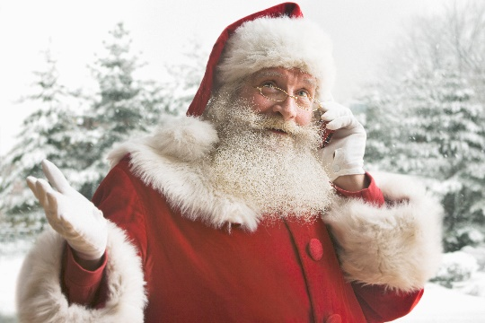
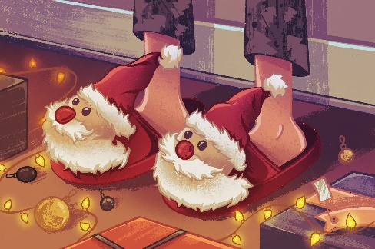
Mrs. Dee’s ABC
Classroom Newsletter
December 16, 2024
Dates to Remember:
12/20 Holiday Party at 10:15
12/20 Early Release
to begin Winter Break
Return to School 1/9/25
Please let me know if you ever have any questions or concerns.
Our holiday party will be on Friday, December 20 at 10:15. Parents are welcome! Here is a link for Signup Genius to help with our party. Please send the items ahead of time so that we will know what all we still need.
https://www.signupgenius.com/go/10C0A4EABA928AAFBC34-54018833-abcholiday
We will be dismissing early. We will be loading the bus and dismissing car riders at 12:00.
We are doing holiday crafts this week in class!
Email: Deanna.Ramirez@fortbendisd.gov
ABC
Pecan Grove Elementary School

